Slide 1

VIT-FAQAssist Chatbot
Presented by - Mayank Gupta 20BCE1538
Guide - Dr. Geetha S.

Slide 2


Chatbot
1.
Why need a contextual chatbot?
Chatbots are a necessary part of good user experience.
Reduces dependency on customer care & provides smooth navigation to users
On conventional web apps, users have to go to a dedicated FAQ section to get info organized under key categories.
FAQs are not served in an interactive manner
No user context is used to narrow down FAQs & show relevant ones

Slide 3
What’s Chatbot?
A chatbot is a conversational agent that interacts with users using natural language.
Numerous applications of chatbots such as Customer Service, call centers etc
You must have used them once

Slide 4
NLU (Natura Language Understanding)
NLU helps the chatbot understand the query by breaking it down. We have used two specific concepts in building our college chatbot:
Entities: An entity represents keywords from the user’s query picked up by the chatbot to understand what the user wants. It is a concept in your chatbot. E.g., ‘Where is VIT’s Location?’ has the word ‘Location’ as an entity.
Intents: It helps identify the action the chatbot needs to perform on the user’s input. For instance, the intent of “Where is VIT” and “What is VIT Location? and “Where is VIT located” is the same. All of these user’s texts trigger a single command giving users options for t-shirts.
Numerous applications of chatbots such as Customer Service, call centers etc

Slide 5
NLU (Natura Language Processing)
Natural Language Processing (NLP) chatbot takes some steps to convert the customer’s text or speech into structured data to select the related answer. Some of the Natural Language Processing steps which we have used are
• Tokenization: The NLP divides a string of words into pieces or tokens. These tokens are linguistically symbolic or are differently helpful for the application.
• Named Entity Recognition: The chatbot program model looks for categories of words, like the name of the product, the user’s name or address, whichever data is required.
Like most applications, the chatbot is also connected to the database.

Slide 6

LITERATURE SURVEY
LITERATURE SURVEY
Author | Method Name | Advantages | Limitations | Analysis
[1] N. N. Khin and K. M. Soe | Seq2Seq Model with Attention | Effective Question Answering in Education | BLEU Score of 0.41 indicates potential accuracy challenges | Further exploration needed to understand limitations and areas for improvement
[2] L. T. Hien et al. | Adobot Approach | Interactive QA for Technical Support | Potential challenges in maintaining and updating ontology-based knowledge base | Long-term effectiveness of Adobot Approach needs investigation, especially in dynamic environments
[3] Eli Stevens, Luca Pietro Giovanni Antiga, Thomas Viehmann | PyTorch for Deep Learning | Engaging and user-friendly Python experience for deep learning | Potential challenges in scalability and integration with other frameworks | Consideration of project requirements and ecosystem compatibility is essential before choosing PyTorch
[4] M. Akhtar, J. Neidhardt, and H. Werthner | Chatbot Conversations Analysis | Insights into user interests and satisfaction | User engagement and satisfaction challenges identified | Deeper understanding of user expectations and proactive measures recommended
VIT-FAQAssist

Slide 7
LITERATURE SURVEY
LITERATURE SURVEY
[5] R. Vannala, S. B. Swathi, and Y. Puranam | AI Chatbot For Answering FAQ’s | Chatbot answers both textual and image-based queries | Challenges in accurately interpreting and responding to image-based queries | Thorough testing and validation required for image-based queries
[6] D. Singh, K. R. Suraksha, and S. J. Nirmala | Deep Learning with NLP for QA | Closed-domain QA system with deep learning and NLP | Difficulty in understanding diverse natural language questions | Further exploration needed for adaptability to evolving language nuances
[7] Prof. Nikita Hatwar, Ashwini Patil, Diksha Gondane | AI-based Chatbot | Utilizes Microsoft’s voice synthesizer | Challenges in achieving widespread adoption due to rapid evolution of voice tech | Continuous updates and integration with latest AI advancements recommended
[8] Rajasshrie Pillai, Brijesh Sivathanu | Adoption of AI-based Chatbots in Tourism | Factors influencing chatbot adoption in tourism | Challenges in implementing user-friendly and effective chatbots | Constant adaptation required for the dynamic tourism industry
[9] Martin Adam, Michael Wessel, Alexander Benlian | AI-based Chatbots in Customer Service | Investigates effects on user compliance using anthropomorphism | Demonstrates increased user compliance with anthropomorphic design cues | Initial step towards understanding AI-based CA effects in electronic markets and customer service
[10] Ulf Hermjakob | Parsing and Question Classification | Machine learning-based parsing and classification | Semantically enriched parse trees improve question parsing | Importance of semantically enriched treebanks for question answering applications
VIT-FAQAssist

Slide 8
VIT-FAQAssist
Business shift towards ChatBot
50% of businesses plan to spend more on chatbots than on mobile apps. 64% of internet users say 24-hour service is the best feature of chatbots. 37% of people use a customer service bot to get a quick answer in an emergency. There were over 300,000 chatbots on Facebook in 2018.
64%
37%
50%
VIT-FAQAssist

Slide 9
VIT-FAQAssist Bot
FROM ‘EXCESS’ TO ‘ACCESS’
VITQuickFAQ is your swift and reliable companion for navigating the frequently asked questions at VIT Chennai. Designed for efficiency, this chatbot streamlines the process of obtaining accurate and timely information. Whether you're seeking details about admissions, course structures, or campus services, VITQuickFAQ is here to provide instant and concise answers
Our Chatbot will be designed for the merchandisers to :
* Student user login & register.
* Browse categories & products• Place, view or cancel orders.
* Frequently Asked Questions(FAQ) answering chatbot, customly built to answer any question related to IEEE-VIT .
* Further, an API is created for the same using FastAPI.
Key Features of the Product :
* Instant Response with automatic time-to-time pop-up(alerts).
* Assist managing team with easy to keep track functionality
* Work Stress Busters with clear & timely reporting.
* Automating Business Operations for Visible Efficiency Gains due to fast communication.
--> Say goodbye to lengthy searches and welcome the quick, hassle-free assistance of VITQuickFAQ – your go-to guide for all things VIT Chennai.
7
Notes:
Food loss and waste reduction should be seen as a means toward achieving other objectives, including improving food security and nutrition, reducing greenhouse gas emissions, lowering pressure on water and land resources and can increase productivity and economic growth. The formulation of effective policies toward food loss and waste reduction requires comprehensive information as to how much and where – both geographically and along the supply chain – various foods are lost or wasted. FAO’s work on measurement and support to countries to take action to reduce food loss and waste is critical to tracking progress made by countries..

Slide 10
15K+
VIT has around 15k+ Students only in Chennai Campus
That’s Huge
With the number only we can understand how hard it is for an administration to manage all of them.

Slide 11
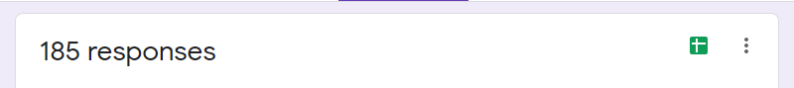
OUR STATs
60% of the students love to use more interactive way like chatbots.
11% via calls
27% via mobile applications etc.
2% want to go for meets.
AGE – 18 to 30
60%
want to use chatbot

Slide 12

Log In
Log off
DAILY ACTIVITY
Initialize the chat
Logged to Database
Authenticate
Output decided
Usery Query Input
Intent Recognized

Slide 13
Step 1
Chat with VITFAQAssist Bot sharing your query.
Step 3
The predicted intent will be matched with given set of answers in output.json
Step 2
Automated bot will tokenize the user-input and predict the intent using pytorch & tensorflow.
Step 4
One of the output for the intent will be chosen and will be sent as reply to the user query

Slide 14
Greetings
OTP Sent + Verified
FAQ
Send Email to admin
Instantly
Initialize
Main Page
Automatically get’s updated to database
History of FAQ
No
Fetch from Database
User Feedback
Yes
Send Email to admin
Instantly
Log Off

Slide 15
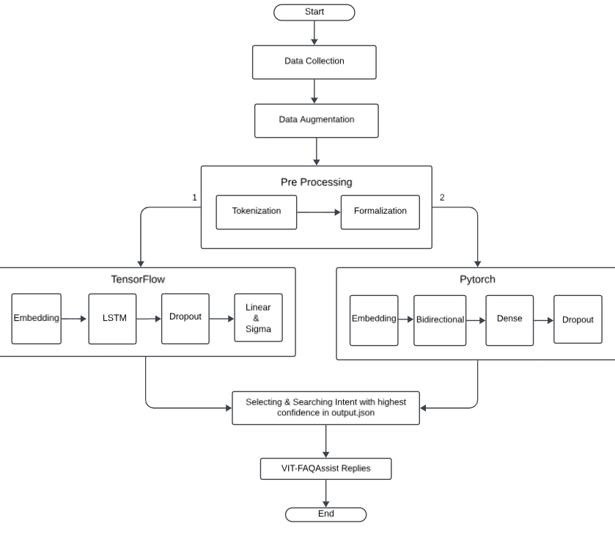

Slide 16
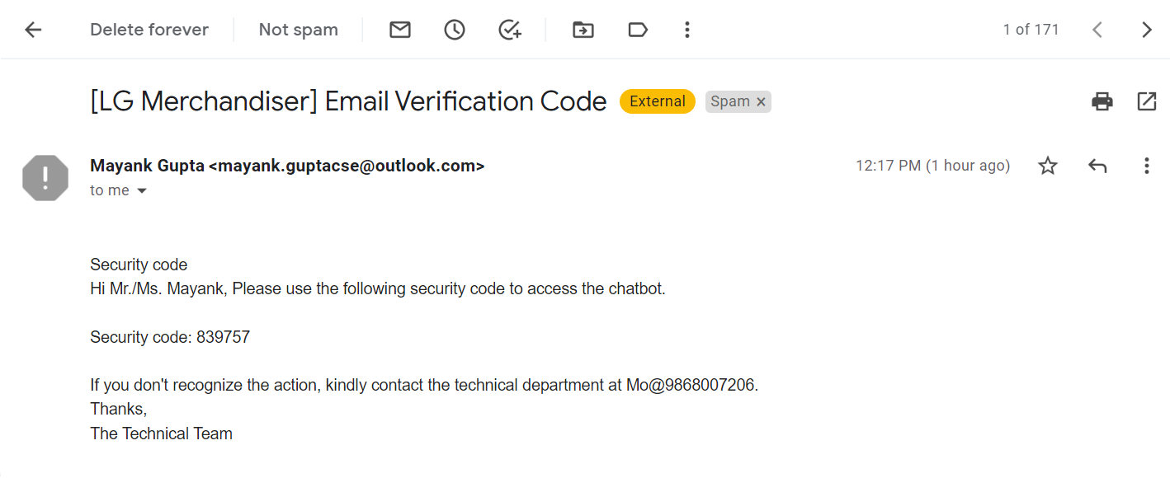
OTP AUTHENTICATION EMAIL SENT TO USER
Email sent to admin

Slide 17
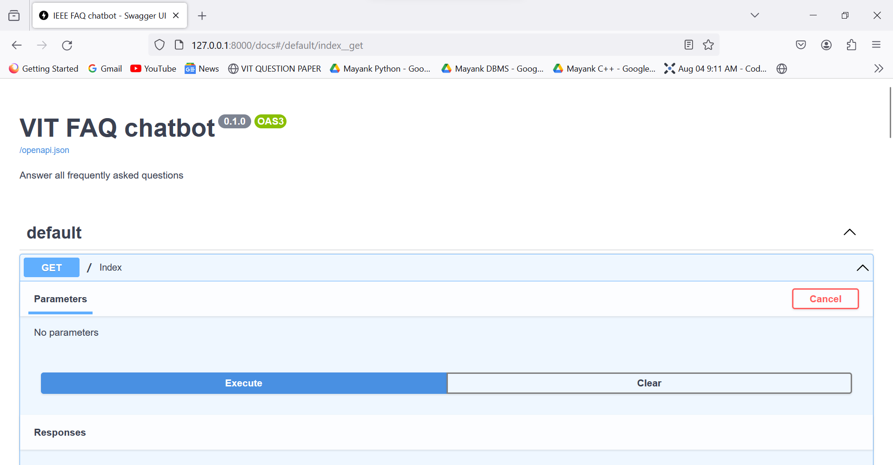
GET API CALL

Slide 18
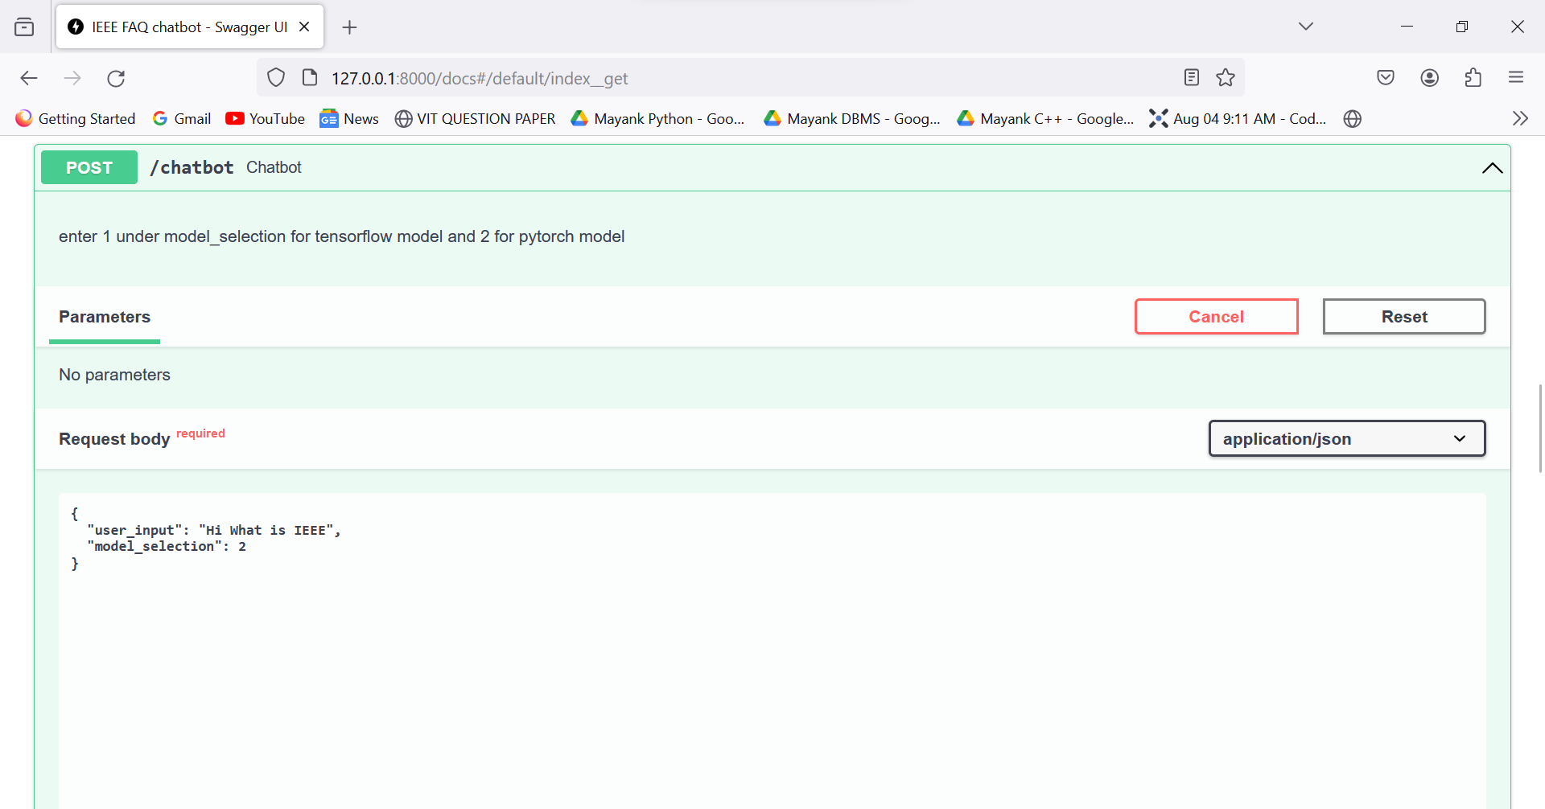
POST API CALL

Slide 19
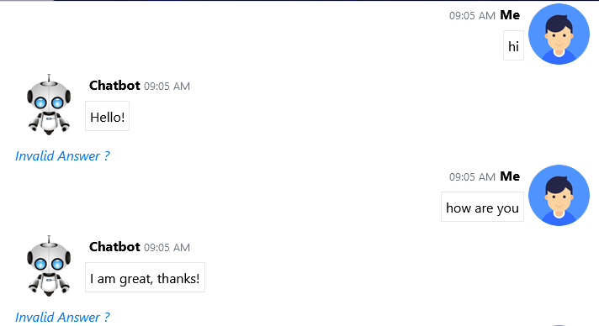
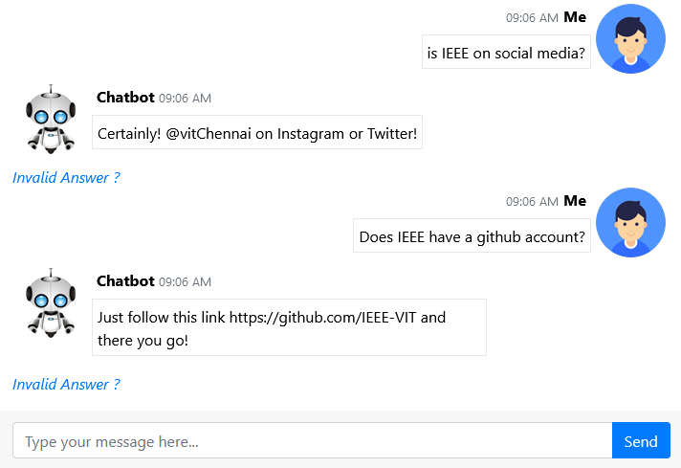
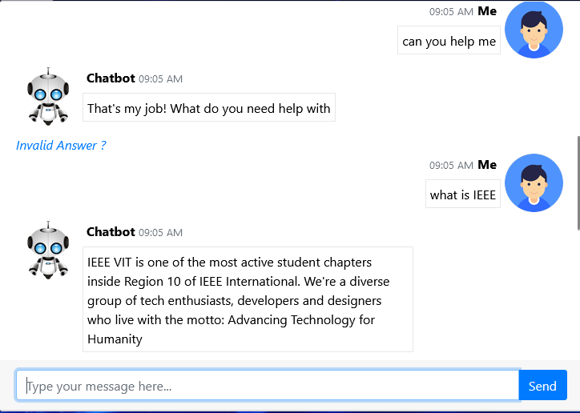
WORKING MODEL SCREEN SHOT

Slide 20
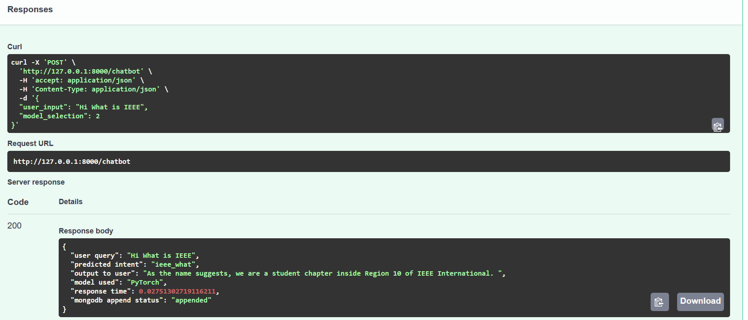
WORKING MODEL SCREEN SHOT

Slide 21

S
W
Efficiency & Speed
Initial Setup &
Training
The chatbot can quickly recognize and respond to student queries, providing instant assistance
Will train the students.
24/7 Availability
It operates round the clock, providing students with support outside regular office hours.
Natural Language
We can train our bot to understand the natural language of the user.
Using Machine Learning model
Cost Efficiency
Continuous Improvement
O
Security & Privacy concern
Multiple Number of users can be added
T
Integration with Other Services
With exposure over internet ,
Recurring Cost
Same application can run over different channels Eg. MSTeams,
Wechat, Email …
A small but recurring amount of Funds paid to azure.

Slide 22
YOU HELD THROUGH !
Thank you!
Prepared by:
Mayank Gupta
20BCE1538 – 4th Yr B.Tech CSE @ VIT CHENNAI

Slide 23
